Slide 1
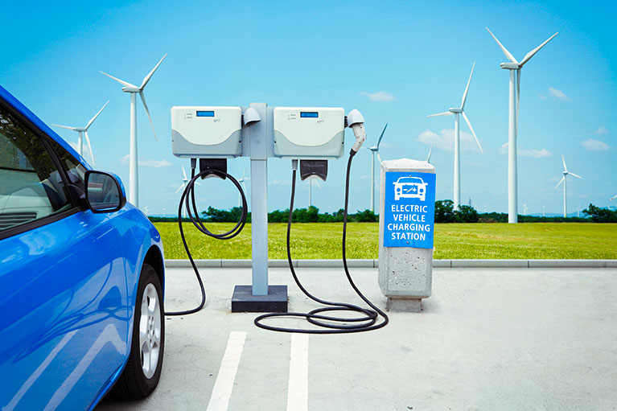
An Investigation into Electric Charging Stations
Vanessa Van Gilder
Sam Stone
Esther Suh

Slide 2
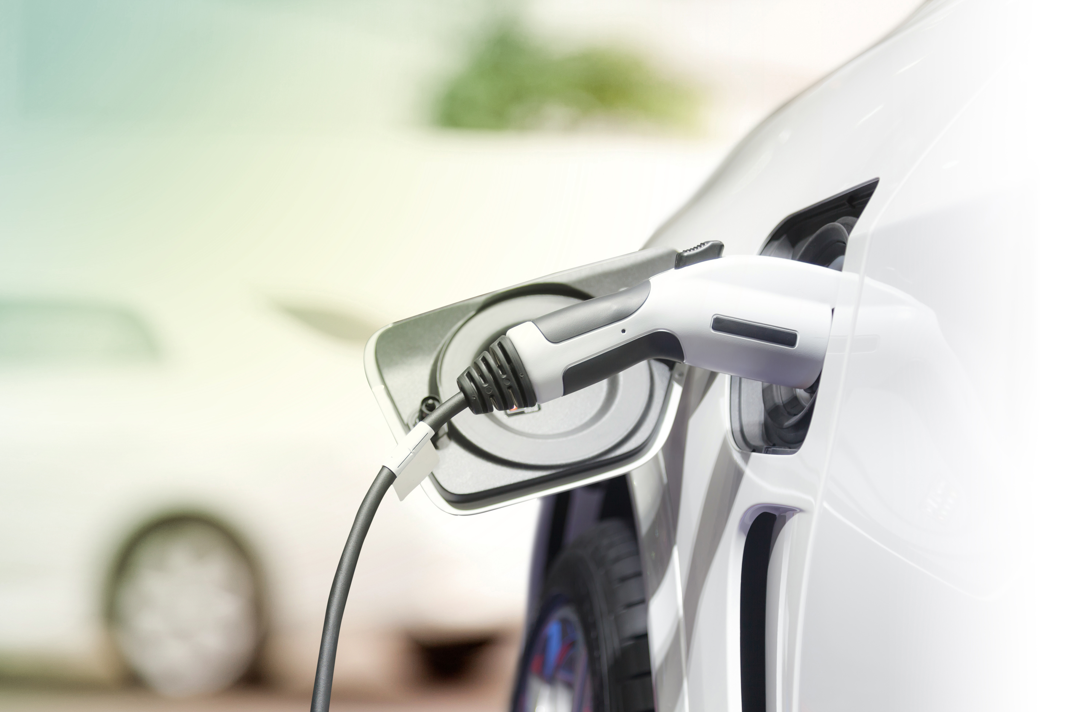
Do these three factors affect the concentration and location of Electric Vehicle (EV) charging stations?
Average Adjusted Gross Income (AGI) by Zip Code
State EV incentives
State Gasoline Taxes

Slide 3
Data
IRS Website – Average AGI:
https://www.irs.gov/statistics/soi-tax-stats-individual-income-tax-statistics-2015-zip-code-data-soi
Alternative Fuels Data Center – Number of EV Charging Stations:
https://www.afdc.energy.gov/data_download
National Bureau of Economic Research - Zip Code Distances: http://www.nber.org/data/zip-code-distance-database.html
US Zip Codes: https://www.unitedstateszipcodes.org/
U.S. Energy Information Administration: https://www.eia.gov/

Slide 4
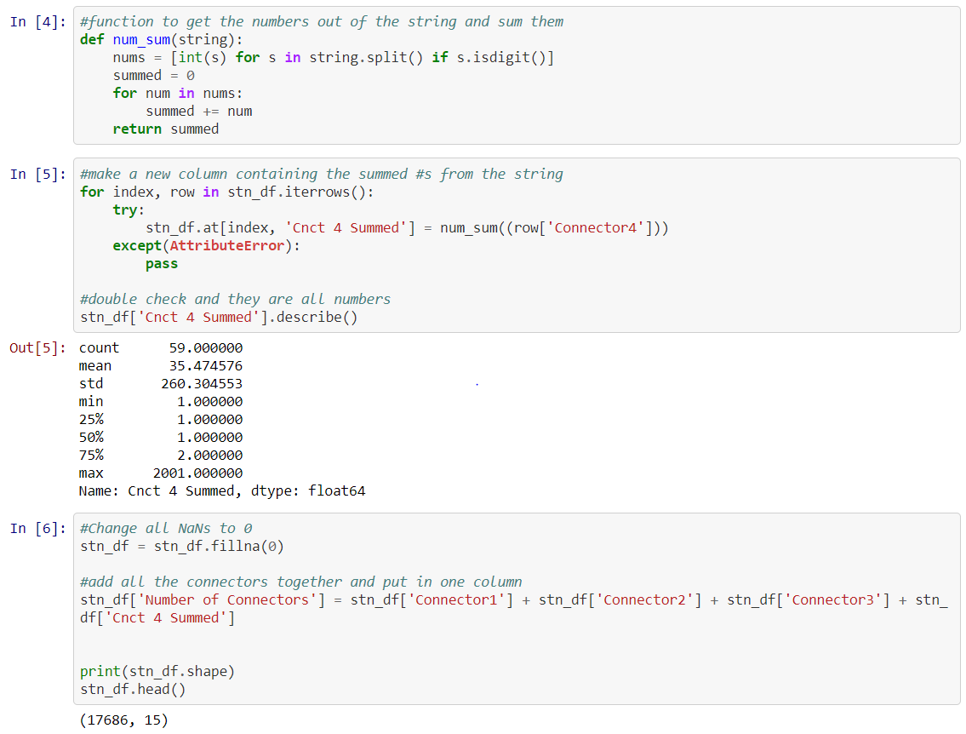
Data Exploration and Clean Up
https://github.com/VanessaVanG/GW_Project1/blob/master/data_exploration_cleanup.ipynb

Slide 5
MAPS on Plot.ly
EV Charging Stations with Average AGI
https://plot.ly/~VanessaVanG/0/ev-charging-stations-with-average-agi-by-zip-code-hover-for-average-agi/
State Incentives with Number of EV Stations and Connector Ports
https://plot.ly/~VanessaVanG/5/state-ev-incentives-with-number-of-stations-and-connector-ports/
State gasoline taxes and fees with Number of EV Stations and Connector Ports
https://plot.ly/~VanessaVanG/9/state-gasoline-taxes-and-fees-with-number-of-stations-and-connector-ports/

Slide 6
Final Data Analysis
1) Average AGI by Zip Code
We found more charging stations in the major metropolitan cities of the state: Silicon Valley, LA, New York, Austin, where most of the population live.
2) State incentives:
the line of regression shows the correlation between number of stations and number of incentives.
3) State Gas Tax and Fees:
shows the weakest correlation per the scatter plot

Slide 7
Conclusions
The other factors we would consider that would have given us stronger correlation would be:
• Population density
• Time lapse that showed the number charging stations over time
• Number of electric cars purchased over time
We’re hoping to see more EV charging stations in the future that would strengthen our findings.

